Slide 1
The Jefferson Era 1800 through 1816
When Jefferson becomes president in 1801 his party replaced the Federalist programs with its own.

Slide 2
The Election of 1800
First presidential election in a two parties election
Federalists led by President John Adams
Democratic Republicans led by Vice President Thomas
Thomas Jefferson
Democratic Republicans thought they were saving the nation from monarchy and oppression
They also thought they were saving the Bill of Rights from the Alien and Sedition Act
The Federalists thought the nation was going to be run by radicals
Demagogues
“Tyranny of the Mob”

Slide 3
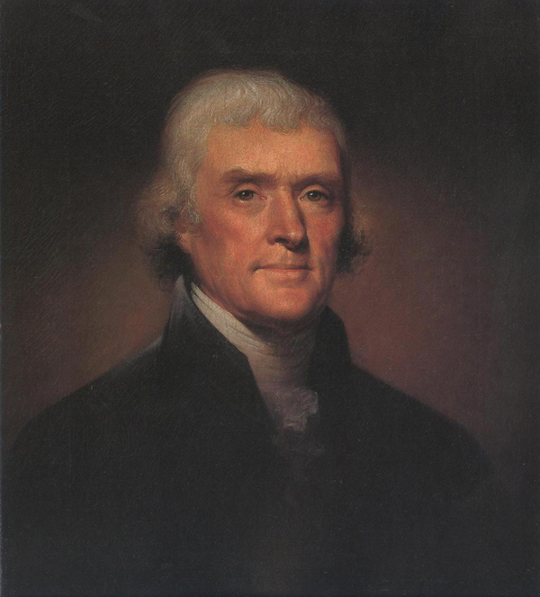
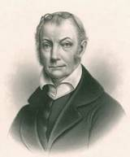
The Democratic-Republicans
Thomas Jefferson
Aaron Burr

Slide 4
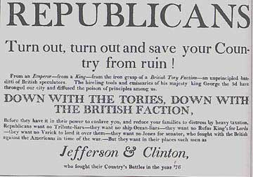
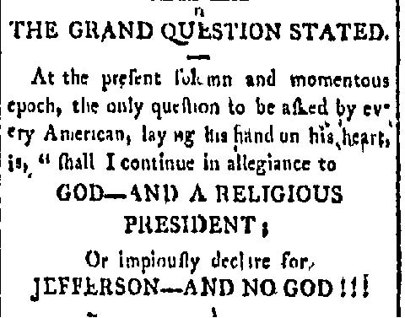
The [Election/Revolution] of 1800
(Again) a major flaw in the Constitution is revealed.
2 votes per elector
Highest Total: President
Second Highest:Vice-Pres.
Democratic-Republicans have a plan!
But it is botched!
The election is a tie between Burr and Jefferson
Let the power play politics begin

Slide 5
Breaking the Tie
According to the constitution the House of Representatives must break the tie between Burr and Jefferson
House of Representative controlled by Federalists!
Who are on their way out the door!
Federalist majority is divided
Both of these men are hated by Federalists!
Many see Jefferson as a radical & dangerous Arch-Nemesis
Others (Hamilton) disliked Burr personally
Hamilton and Burr were old rivals from NY
Over a period of seven days the House voted 35 times without determining a winner.
On the - 36th ballot - Hamilton persuades his friends not to vote, throwing the election to Jefferson
Better a man with wrong principals than none.

Slide 6
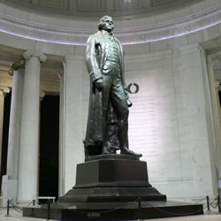
Thomas Jefferson
Renaissance Man
Statue -worthy!
Architect
Botanist
Violinist
Personal Library becomes the seed for the Library of Congress
“I think this is the most extraordinary collection of talent, of human knowledge, that has ever been gathered at the White House - with the possible exception of when Thomas Jefferson dined alone.”
John F. Kennedy welcoming of a group of Nobel Prize winning guests

Slide 7
Thomas Jefferson
Political Philosophy
Wealthy aristocrat!
No Public Debt
Low Taxes
Nation of Small Farmers
Listen to the Voice of the People
Laissez-Faire Government
“Let us, then, fellow-citizens, unite with one heart and one mind every difference of opinion is not a difference of principal we are all Republicans, we are all Federalists”
Thomas Jefferson, first inaugural address

Slide 8
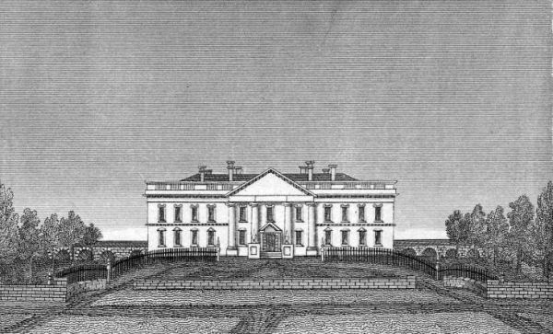
Undoing Federalist’s Policies
Domestic Policy
Jefferson’s white house
Urge D-R Controlled congress to allow Alien and Sedition acts to expire.
End Whiskey Tax
Halts ship construction
Releases ½ of army
Cuts Federal employees
Works to undo Hamilton’s financial plan

Slide 9
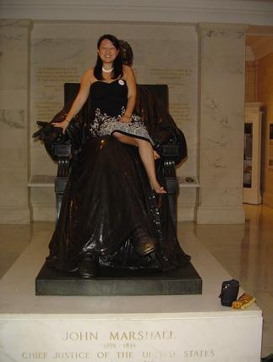
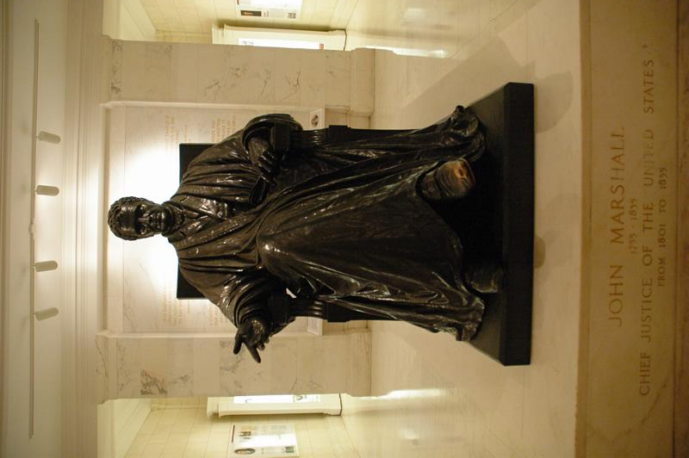
Federalist Influence Persists
The “Midnight Judges”
John MarshalL (Age 45)
The Judiciary Act of 1801
Reorganizes Supreme Court
Creates many new courts
Addresses “backburnered” problems with Supreme Court
Passed by outgoing Federalists
John Adams appoints many judges with lifetime appointments.

Slide 10
Marbury v. Madison
The Conflict
The Solution
John Adams appoints William Marbury to the courts as Justice of the Peace, but it was delivered after Adams left office.
Secretary of State James Madison refuses to seat him
Marbury sues to force the issue
Declares the law being challenged unconstitutional.
Unconstitutional: contrary to the laws of the Constitution
In this case Marshall and the court establish judicial review

Slide 11
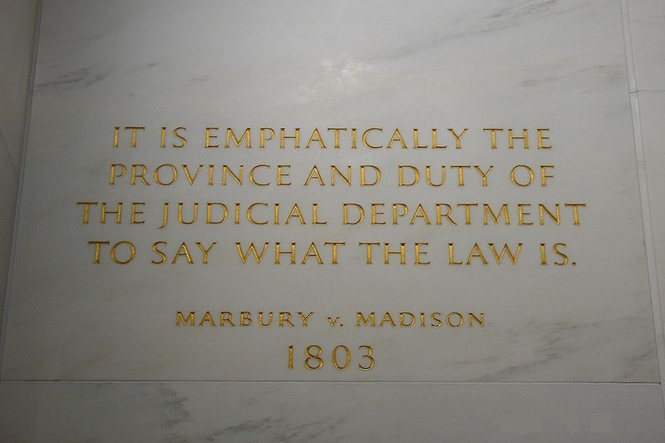
Concequences
Judicial Review
Money quote
Judicial Review: the courts have the final say in interpreting the Constitution
This idea helps establish balance between the three government branches
Appears nowhere in the Constitution
Jefferson and Madison are angry at the power grab, but don’t fight it because they got the decision they wanted.

